Slide 1
K Means Clustering
Set up T4 Machine – 15 min
Progress check – 5 min
Hands on – 45 min
Assignment – 5 min
Next level – 10 min

Slide 2
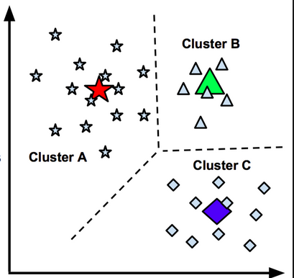
K Means Clustering Unsupervised learning
K-means is an iterative algorithm and it does two steps:
Cluster assignment: chooses the initial centroids
Move centroid step: The first step assigns each sample to its nearest centroid. The second step creates new centroids by taking the mean value of all of the samples assigned to each previous centroid.
Notes:
https://medium.com/@dilekamadushan/introduction-to-k-means-clustering-7c0ebc997e00

Slide 3
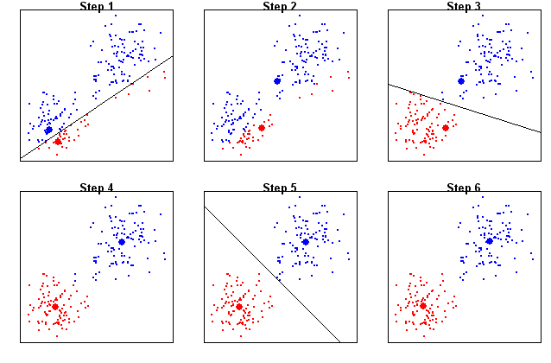
Clustering How centres are identified
Notes:
https://medium.com/@dilekamadushan/introduction-to-k-means-clustering-7c0ebc997e00

Slide 4
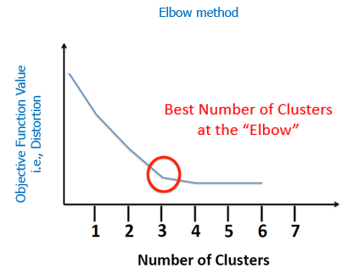
Elbow Method How to determine the number of clusters
run k-means clustering on the dataset for a range of values of k (say, k from 1 to 10 in the examples above), and for each value of k calculate the sum of squared errors (SSE)
Then, plot a line chart of the SSE for each value of k. If the line chart looks like an arm, then the “elbow” on the arm is the value of k that is the best. The idea is that we want a small SSE, but that the SSE tends to decrease toward 0 as we increase k (the SSE is 0 when k is equal to the number of data points in the dataset
Notes:
https://medium.com/@dilekamadushan/introduction-to-k-means-clustering-7c0ebc997e00

Slide 5
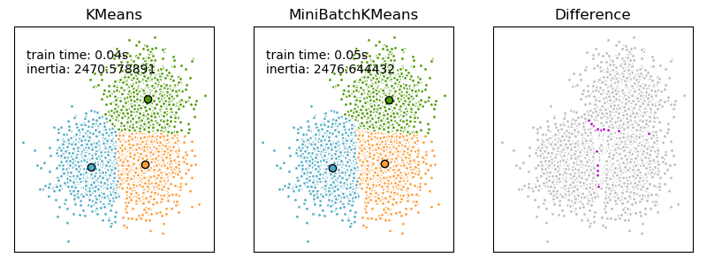
Minbatch K Means Clustering Variation of K means clustering to minimize the computation time, although with slight impact to accuracy
Notes:
https://medium.com/@dilekamadushan/introduction-to-k-means-clustering-7c0ebc997e00

Slide 6
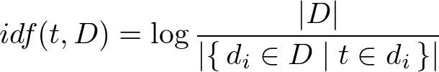

Tf-iDF Term frequency – inverse document frequency
Term Frequency is just ratio number of current word to the number of all words in document/string/etc.
Higher the number of term’s occurrence in a document, higher will be the ratio
Inverse Document Frequency is a log of the ratio of the number of all documents/string in the corpus to the number of documents with term t_i.
If a term is appearing in several of the documents, it has less importance as the ratio will be lower.
tf-idf(t, d, D) is the product tf(t, d) to idf(t, D).
Notes:
https://medium.com/@dilekamadushan/introduction-to-k-means-clustering-7c0ebc997e00

Slide 7
Assignment – Due 29 July 20 News groups
20newsgroup data set has 20 topics of news (dataset included in the K-Means kernal).
Apply k-Means clustering to 20newsgroup dataset. Can you recognize respective topic?
Among others techniques, LDA and NMF are two more approaches used for topic modelling. Lookup respective code on LDA and NMF. Apply these two approaches as well in topic modelling.
Compare the results from all three approaches and see which one gives the best result for you. Submit a file with following:
Original Topics as per 20 news group
Topic keywords as per K-Means
Topic Keywords as per LDA
Topic keywords as per NMF
Feel free to try any other method and provide result
About News Group Dataset: https://www.cs.cmu.edu/afs/cs/project/theo-20/www/data/news20.html
Notes:
https://medium.com/@dilekamadushan/introduction-to-k-means-clustering-7c0ebc997e00

Slide 8
Intermediate level tests and next level Criteria to attend advanced modules
After the completion of intermediate level, there will be two tests (Kaggle Competition and In house problem set). Below is the criteria how intermediate level scores will be calculated. Based on this, I will decide if participant can advance to next level.
Competition ranking – 40%
Compared to the DS group – 75%
Compared to overall competition leader board – 25%
Ranking based on solution for in house Problem set – 50%
Trainers feedback – 10%
Notes:
https://medium.com/@dilekamadushan/introduction-to-k-means-clustering-7c0ebc997e00

